Slide 1
Demystifying Data Science:
What the Heck is Machine Learning?
August 23, 2017

Slide 2
Who am I?
Recovering nuclear physicist (PhD)
Data management and analysis junkie
Educator: physics, math, computer science, astronomy, data science
Senior data scientist at Metis

Slide 3

Data science and machine learning educators
12 week intensive bootcamps
Part-time live-online courses
Corporate training

Slide 4
What is a data scientist?

Slide 5
Data scientists are generally...
Organizing and aggregating data
Analyzing that data to try to find patterns
Building pipelines to handle incoming data
Converting data into insights

Slide 6
Data scientists are generally...
Organizing and aggregating data
Analyzing that data to try to find patterns
Building pipelines to handle incoming data
Converting data into insights
We’ll focus on these sections today.

Slide 7
Why is big data a problem?

Slide 8
Which number is missing?
0 1 2 3 4 5 7 8 9

Slide 9
Which number is missing?
0 1 2 3 4 5 7 8 9
6

Slide 10
Which number is missing?
3 0 2 8 5 1 6 9 7

Slide 11
Which number is missing?
3 0 2 8 5 1 6 9 7
4

Slide 12
Which number is missing?
4 2 3 3 0 7 3 4 0 4 0 0 1 0 8 0 6 8 2 7 0 3 7 1 4 6 0 0 1 7 8 9 9 2 3 2 1 3 3 4 2 3 0 6 7 3 2 3 2 8 1 6 6 3 2 3 8 4 0 3 6 1 4 7 4 0 4 4 0 0 7 3 4 1 6 0 8 3 0 3 4 6 1 2 4 0 8 0 3 1 2 7 2 2 3 4 0 9 1 1 6 8 8 1 9 9 4 3 3 1 4 8 2 1 4 3 3 8 4 1 3 9 1 9 4 8 6 4 2 4 4 9 6 2 7 3 4 2 0 6 4 6 6 3 6 0 8 9 4 1 7 1 0 1 0 0 2 3 3 3 8 1 2 9 9 4 3 6 7 6 8 7 4 2 7 8 6 2 7 0 7 1 0 0 6 4 0 9 6 9 2 3 1 3 1 0 2 9 1 1 4 2 4 1 3 8 6 8 4 0 6 0 8 1 9 4 1 1 0 1 9 0 2 9 0 9 8 1 2 2 2 1 7 3 3 9 1 1 7 9 8 9 7 7 6 0 1 3 1 3 2 1 8 4 4 6 4 0 4 4 9 2 0 1 3 6 9 1 6 3 6 1 0 2 3 0 9 6 9 2 3 7 6 9 3 1 4 6 6 2 2 6 1 6 0 2 1 3 7 3 4 3 1 4 1 4 1 6 2 3 8 9 0 4 3 2 3 3 1 7 2 3 9 8 0 1 7 7 8 6 4 1 7 6 4 2 2 9 9 6 2 4 4 7 2 0 1 2 8 3 1 2 1 0 2 1 9 0 1 0 3 3 2 9 1 3 4 0 4 6 4 7 0 1 3 1 2 7 0 2 3 2 0 6 1 3 3 1 3 4 0 2 0 8 3 6 9 1 9 2 8 0 8 3 9 4 0 6 9 0 6 3 0 8 0 6 7 7 2 2 2 9 4 2 2 4 2 0 2 7 6 7 8 1 4 6 7 0 0 7 7 8 7 8 3 1 0 1 8 9 0 2 2 1 9 4 6 2 4 8 0 9 3 6 3 3 1 3 6 1 4 1 7 0 4 8 7 0 8 6 8 1 7 2 1 2 0 2 1 8 2 8 8 4 8 9 8 6 3 3 8 1 6 8 6 2 1 2 8 8 0 7 2 6 6 4 6 6 8 8 2 4 0 6 2 3 1 3 4 0 3 7 1 3 4 8 1 1 0 0 0 2 4 0 8 2 0 9 7 4 9 1 1 9 9 8 8 3 3 2 3 2 8 1 9 6 0 4 8 7 6 6 8 1 3 8 6 6 9 8 6 1 4 3 9 4 6 1 6

Slide 13
Which number is missing?
4 2 3 3 0 7 3 4 0 4 0 0 1 0 8 0 6 8 2 7 0 3 7 1 4 6 0 0 1 7 8 9 9 2 3 2 1 3 3 4 2 3 0 6 7 3 2 3 2 8 1 6 6 3 2 3 8 4 0 3 6 1 4 7 4 0 4 4 0 0 7 3 4 1 6 0 8 3 0 3 4 6 1 2 4 0 8 0 3 1 2 7 2 2 3 4 0 9 1 1 6 8 8 1 9 9 4 3 3 1 4 8 2 1 4 3 3 8 4 1 3 9 1 9 4 8 6 4 2 4 4 9 6 2 7 3 4 2 0 6 4 6 6 3 6 0 8 9 4 1 7 1 0 1 0 0 2 3 3 3 8 1 2 9 9 4 3 6 7 6 8 7 4 2 7 8 6 2 7 0 7 1 0 0 6 4 0 9 6 9 2 3 1 3 1 0 2 9 1 1 4 2 4 1 3 8 6 8 4 0 6 0 8 1 9 4 1 1 0 1 9 0 2 9 0 9 8 1 2 2 2 1 7 3 3 9 1 1 7 9 8 9 7 7 6 0 1 3 1 3 2 1 8 4 4 6 4 0 4 4 9 2 0 1 3 6 9 1 6 3 6 1 0 2 3 0 9 6 9 2 3 7 6 9 3 1 4 6 6 2 2 6 1 6 0 2 1 3 7 3 4 3 1 4 1 4 1 6 2 3 8 9 0 4 3 2 3 3 1 7 2 3 9 8 0 1 7 7 8 6 4 1 7 6 4 2 2 9 9 6 2 4 4 7 2 0 1 2 8 3 1 2 1 0 2 1 9 0 1 0 3 3 2 9 1 3 4 0 4 6 4 7 0 1 3 1 2 7 0 2 3 2 0 6 1 3 3 1 3 4 0 2 0 8 3 6 9 1 9 2 8 0 8 3 9 4 0 6 9 0 6 3 0 8 0 6 7 7 2 2 2 9 4 2 2 4 2 0 2 7 6 7 8 1 4 6 7 0 0 7 7 8 7 8 3 1 0 1 8 9 0 2 2 1 9 4 6 2 4 8 0 9 3 6 3 3 1 3 6 1 4 1 7 0 4 8 7 0 8 6 8 1 7 2 1 2 0 2 1 8 2 8 8 4 8 9 8 6 3 3 8 1 6 8 6 2 1 2 8 8 0 7 2 6 6 4 6 6 8 8 2 4 0 6 2 3 1 3 4 0 3 7 1 3 4 8 1 1 0 0 0 2 4 0 8 2 0 9 7 4 9 1 1 9 9 8 8 3 3 2 3 2 8 1 9 6 0 4 8 7 6 6 8 1 3 8 6 6 9 8 6 1 4 3 9 4 6 1 6
5

Slide 14
Let’s look at some more realistic examples
Age | Salary | Loan Amount | Paid Back
21 | 25K | 5K | N
23 | 30K | 5K | N
34 | 30K | 5K | N
22 | 50K | 5K | Y
37 | 55K | 5K | Y
26 | 75K | 5K | Y

Slide 15
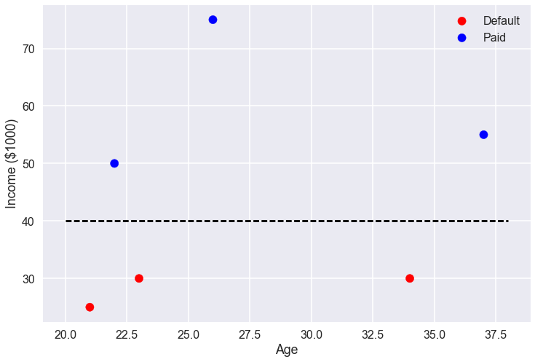

Slide 16
Age | Salary (K) | Loan Amount (K) | Paid Back
21 | 25 | 5 | N
23 | 30 | 5 | N
34 | 30 | 5 | N
22 | 50 | 5 | Y
37 | 55 | 5 | Y
26 | 75 | 5 | Y
43 | 51 | 10 | Y
57 | 43 | 20 | N
21 | 23 | 3 | N
23 | 35 | 7 | Y
22 | 16 | 65 | N
39 | 110 | 25 | Y
36 | 93 | 17 | N
45 | 130 | 10 | Y
52 | 80 | 11 | Y
61 | 63 | 16 | Y
27 | 43 | 8 | N
18 | 25 | 5 | N
29 | 100 | 9 | N

Slide 17
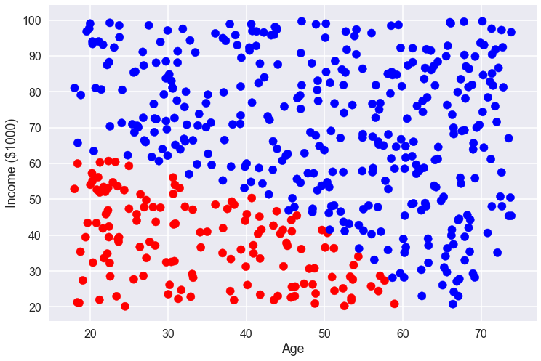

Slide 18
